Slide 1
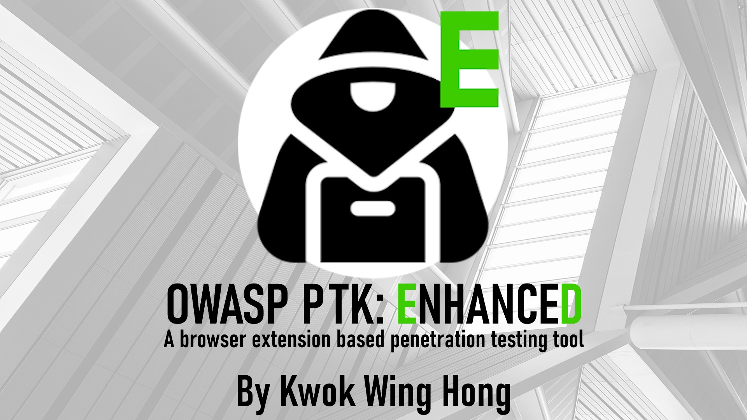

Slide 2

Project Vision
OWASP Penetration Testing Kit: Enhanced (OWASP PTK: Enhanced) is a Firefox browser extension penetration testing tool for web applications. A forked version of the original OWASP Penetration Testing Kit with additional features and functionalities.

Slide 3
What is a fork?
In software development, a fork is a copy of a project that is created by a different team of developers from the original project.
Using the entire or part of the source code from the original project as foundation and start development on it.
Forks are considered a distinct and a separate piece of software.

Slide 4
Browser Extension
Pros:
Real-time access to browser content
Faster speed
Easy installation and update
Cross platform compatibility
Cons:
Less scalability
Less cpu efficient
Simpler features
Less customizability

Slide 5
OWASP Top 10
A documentation of the top 10 web application security risks and guidelines for how to prevent or mitigate the risk.
Published by the Open Worldwide Application Security Project (OWASP)
An industry standard for web application security
Both this project and the original project are contributions to the OWSAP community.

Slide 6
Project Scope
Considerations:
Relevance to OWASP Top 10
Technological Feasibility
Alignment with the original project
Independence

Slide 7
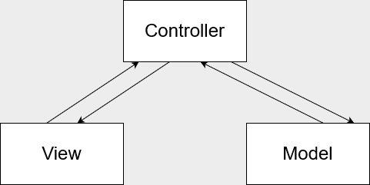


System Design Approach

Slide 8


Implementation

Slide 9
LSEP
Legal, Social, Ethical, And Professional Issues:
Legal: Intellectual property rights
Social: Impact on individuals and organizations
Ethical: Accessibility
Professional: Compentence

Slide 10
The end

